Slide 1

Cyprus Island Analysis

Slide 2
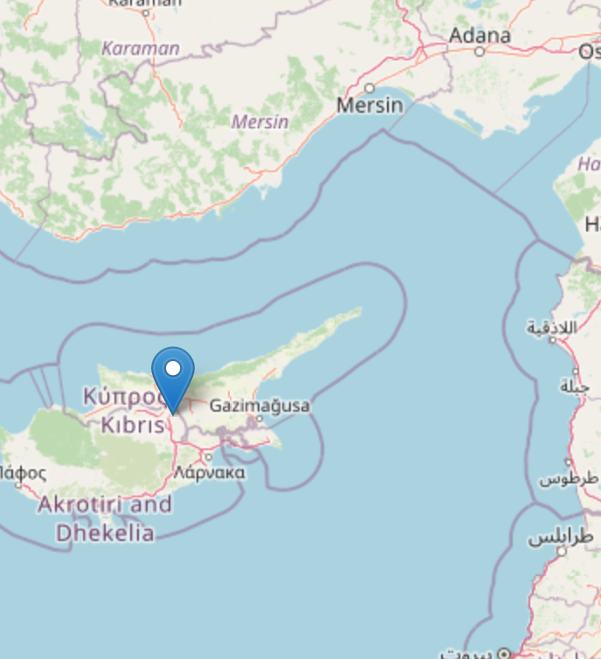
General Description of Cyprus
Cyprus is an island country located in the Eastern Mediterranean Sea, south of Turkey, west of Syria and Lebanon, northwest of Israel, and southeast of Greece. With a strategic location at the crossroads of Europe, Asia, and Africa, Cyprus has been a significant trade and cultural hub throughout history.

Slide 3
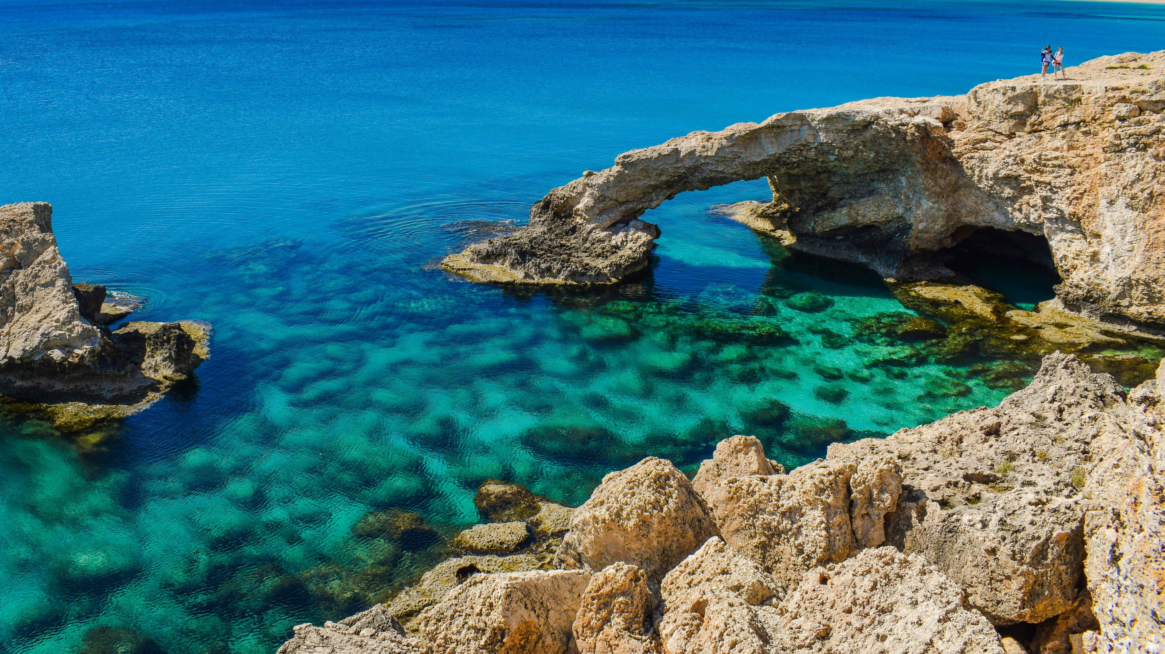
History With over 9,000 years of history, Cyprus has been influenced by many civilizations, including Greeks, Romans, Byzantines, Ottomans, and the British. It gained independence in 1960, but ethnic tensions led to the island's division in 1974. Efforts to reunify continue.
Government Cyprus is a presidential republic, with the President serving as both head of state and government. The island is divided between the Republic of Cyprus in the south and the Turkish Republic of Northern Cyprus, recognized only by Turkey, in the north.
Economy Cyprus has a developed, service-based economy driven by tourism, shipping, financial services, and real estate. A member of the EU, it uses the Euro and is known for its low corporate tax rates, attracting international businesses.
Natural Environment Cyprus has a Mediterranean climate with hot summers and mild winters. Known for its beaches, mountains like the Troodos range, and diverse wildlife, the island is home to species such as the Mediterranean monk seal and green turtles.

Slide 4

Trend of Key Variable

Slide 5
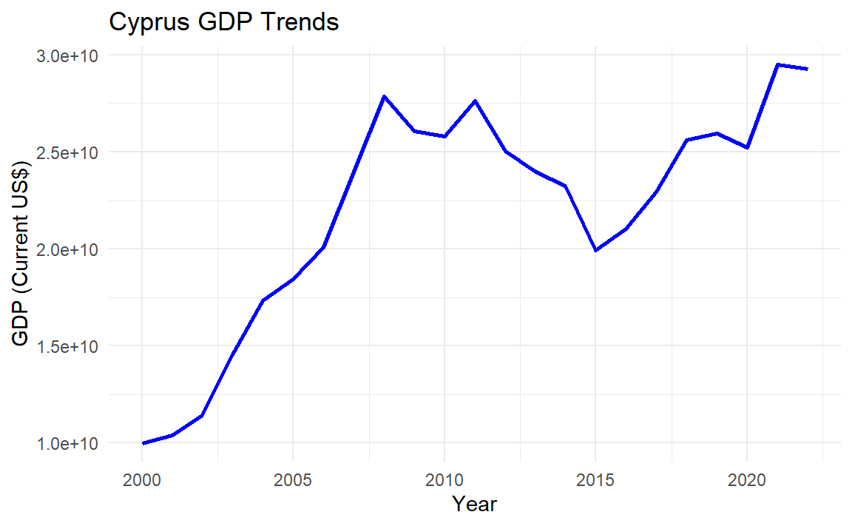
Cyprus' GDP has grown steadily over the years, driven by its robust service sector and thriving tourism industry. Despite occasional global economic challenges, the country has demonstrated resilience and steady economic progress.

Slide 6
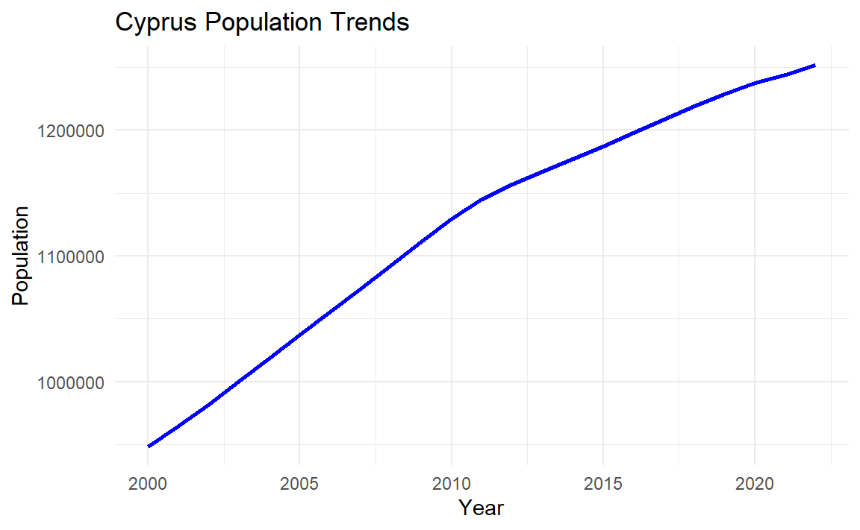
Cyprus' population has shown gradual growth, supported by stable birth rates and immigration trends. This growth reflects the country's economic stability and social infrastructure.

Slide 7
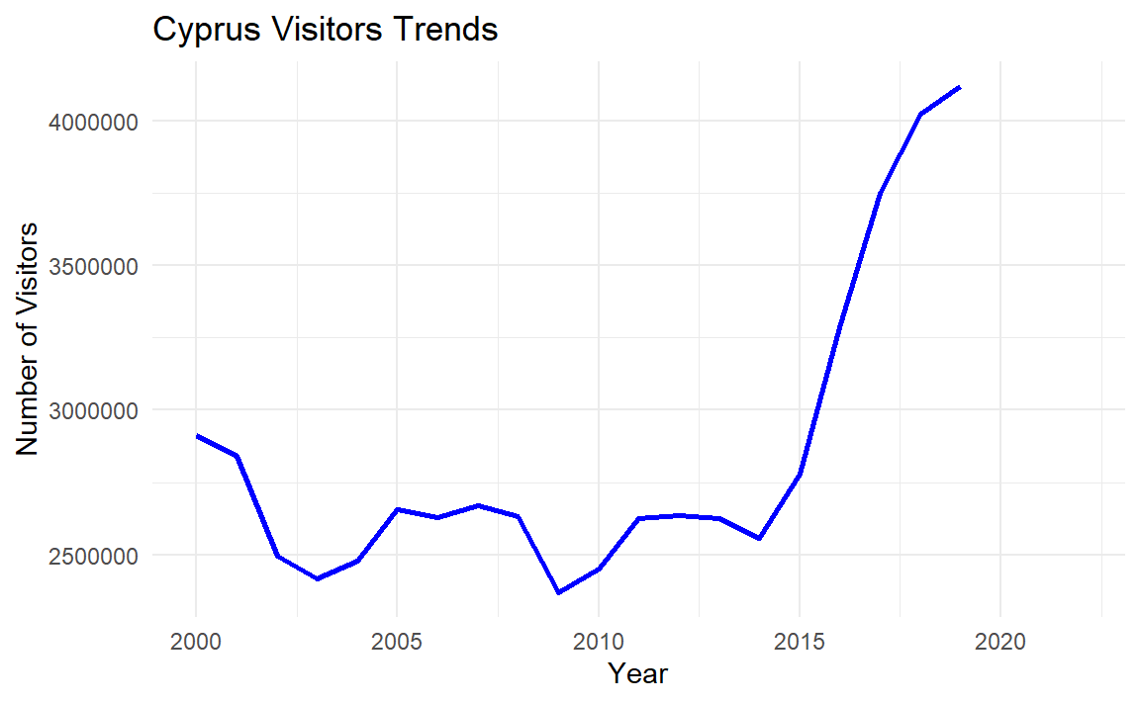
Visitor trends highlight Cyprus' strong tourism sector. The island remains a popular Mediterranean destination, with visitor numbers increasing steadily in most years.

Slide 8
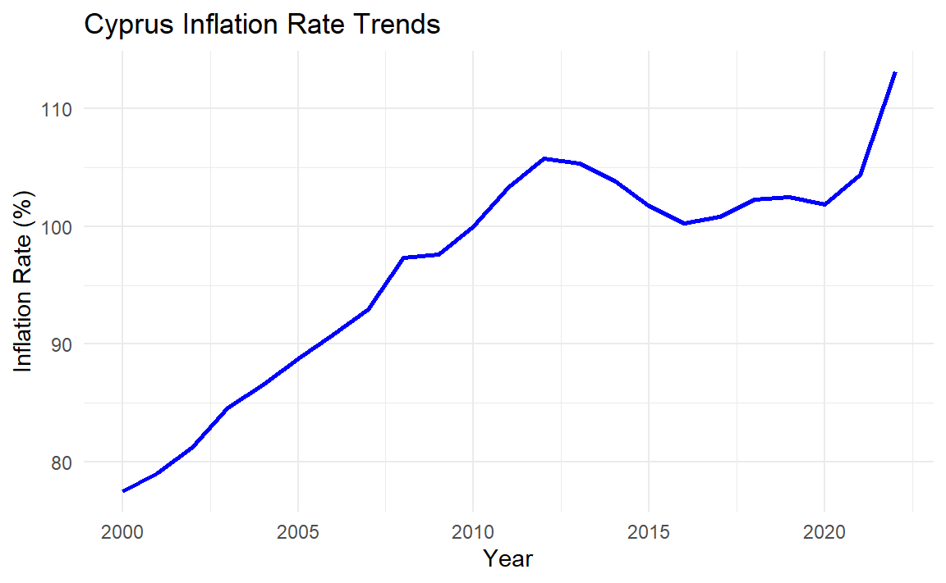
Inflation rates in Cyprus have experienced fluctuations in response to global economic conditions and domestic policy changes. The country has managed to maintain a relatively stable inflation environment.

Slide 9
Comparison with Other Islands

Slide 10
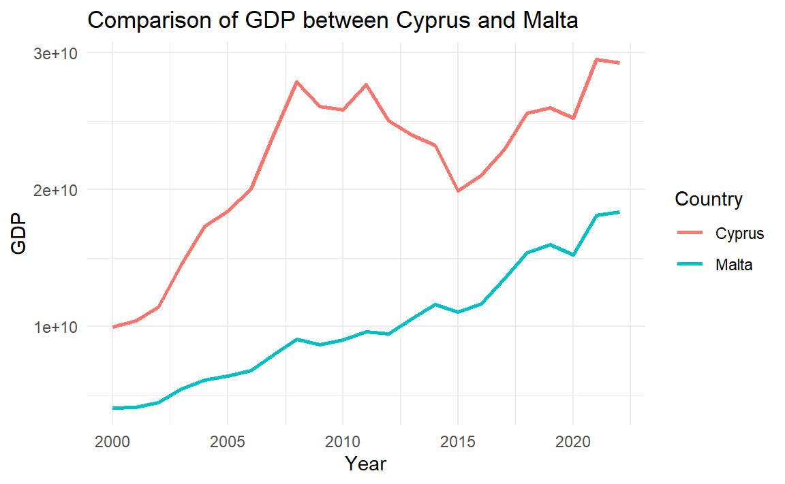
The GDP comparison reveals that both Cyprus and Malta have experienced significant growth over the years. Cyprus generally maintains a higher GDP, reflecting its larger population and a more diversified economy, which includes sectors like tourism, shipping, and financial services. Malta, on the other hand, has shown rapid growth in recent years due to its thriving technology and gaming industries.

Slide 11
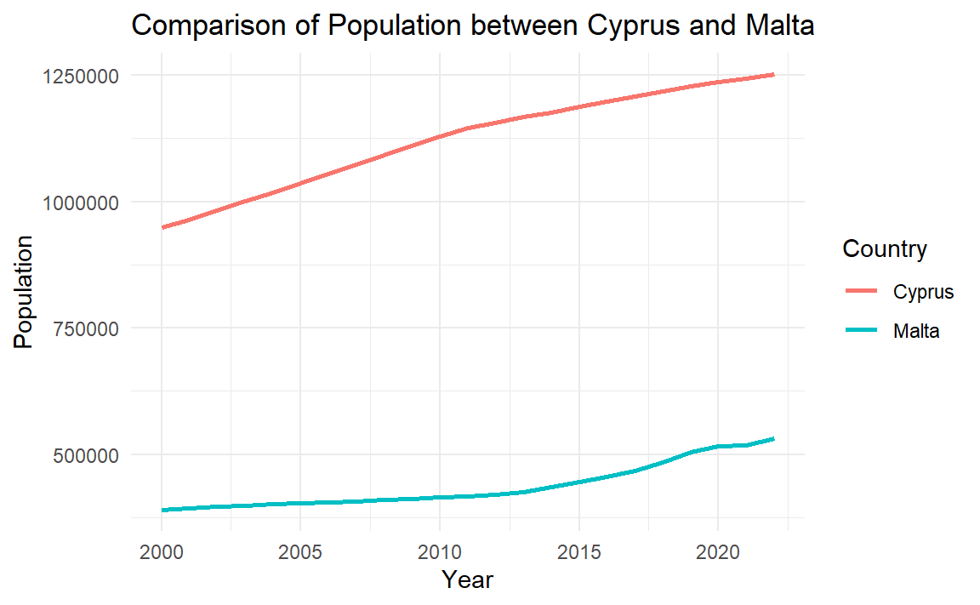
Cyprus has a relatively larger and more stable population compared to Malta. While both countries have seen only modest changes in population over the years, Cyprus' larger geographic size and economic structure support a higher population. Malta's smaller land area and reliance on international migration have kept its population comparatively lower.

Slide 12
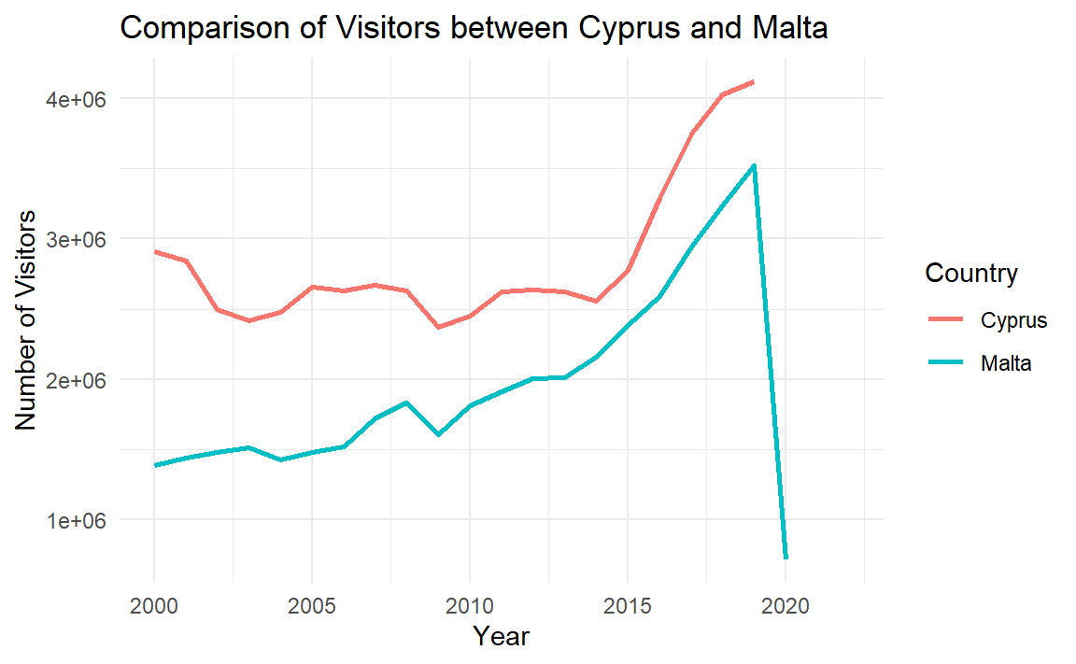
Tourism is a cornerstone of both Cyprus and Malta's economies. Cyprus consistently attracts more visitors, leveraging its larger size, diverse attractions, and rich historical sites. Malta, while smaller, has carved a niche in luxury and heritage tourism, drawing a steady influx of high-value travelers.

Slide 13
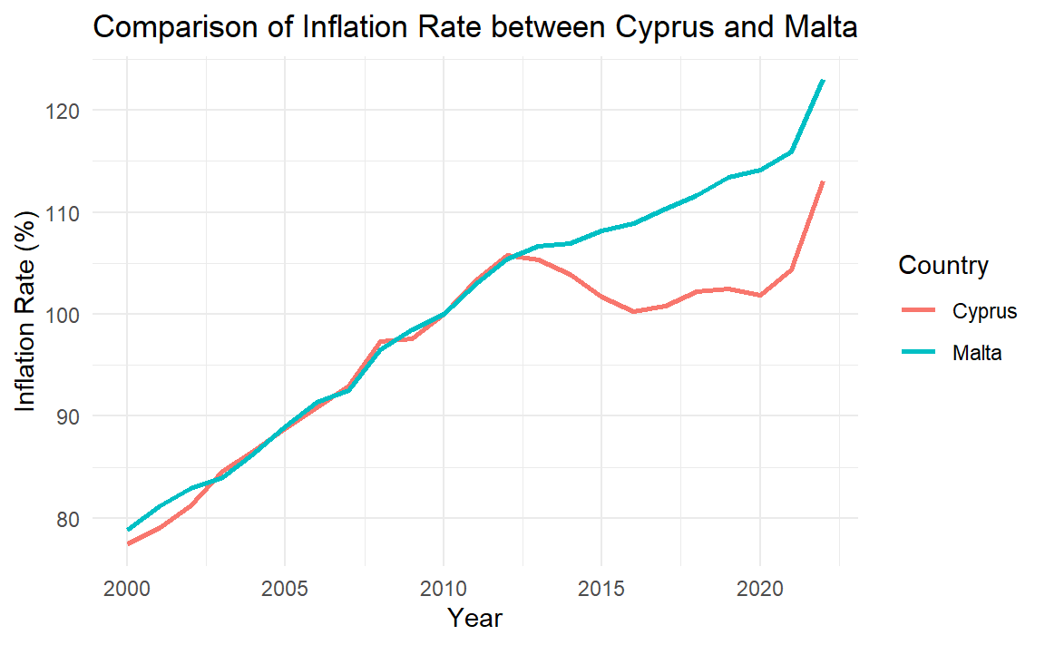
Inflation rates in Cyprus and Malta show fluctuations over time, often in response to global economic conditions and local fiscal policies. Cyprus' inflation has historically been impacted by its dependence on imported goods and energy prices. Malta, with its smaller domestic market, has experienced periods of sharper inflation due to supply chain constraints.

Slide 14
Population Projection

Slide 15
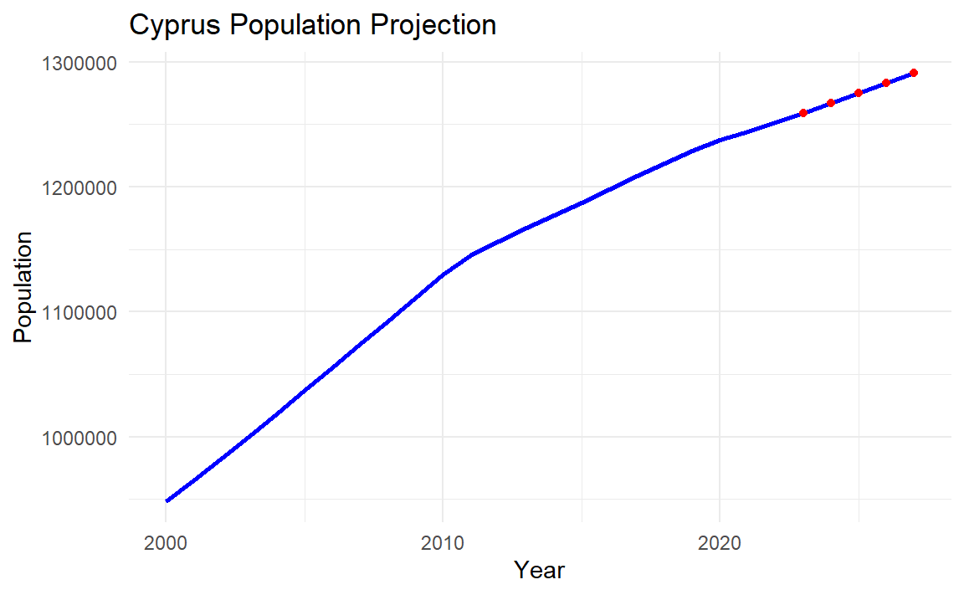
Population Projection
The population projection for Cyprus was conducted using an ARIMA (Auto-Regressive Integrated Moving Average) time series model, a widely used method for forecasting based on historical data trends. Historical population data from 2000 to 2022 served as the input for model training. The ARIMA model was automatically tuned to identify optimal parameters, ensuring the best fit to historical data while balancing the complexity of the model.
This projection suggests a continued moderate upward trend, aligning with historical growth patterns. Factors contributing to this growth include a positive natural growth rate, where the birth rate has consistently surpassed the death rate, and stable socioeconomic conditions that support demographic stability. While the ARIMA model captures historical trends effectively, it assumes no major disruptive events such as significant policy changes or economic crises. These projections provide insights for policymakers and planners to anticipate resource needs and demographic changes.

Slide 16
SWOT Analysis

Slide 17

Strengths
Strategic Location: Positioned at the intersection of Europe, Asia, and Africa, Cyprus benefits from its strategic location for trade and cultural exchanges, enhancing its geopolitical and economic significance.
Tourism Appeal: Cyprus is a renowned Mediterranean destination, attracting millions of tourists annually with its beaches, ancient landmarks, and warm climate, making tourism a vital sector for the economy.
Cultural and Historical Richness: The island’s rich history and UNESCO World Heritage sites, such as the painted churches in Troodos and the ruins of Paphos, contribute to its global cultural standing and tourism appeal.

Slide 18
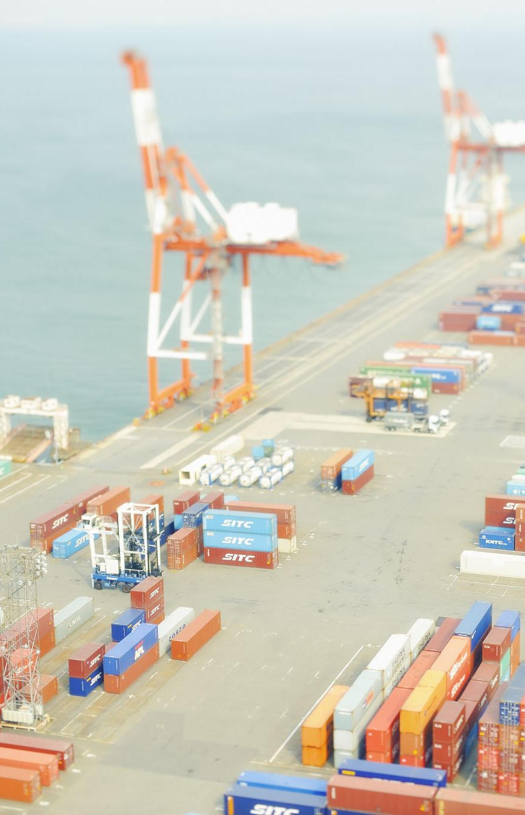
Weaknesses
Political Division: The ongoing division between the Republic of Cyprus and the Turkish Republic of Northern Cyprus complicates governance and international relations, limiting economic and social integration.
Economic Vulnerability: A heavy reliance on tourism and the services sector makes the economy susceptible to external shocks, such as global crises or shifts in travel behavior.
Resource Dependence: Cyprus lacks significant natural resources, necessitating substantial imports for energy and other essentials, which increases economic vulnerability to global supply chain disruptions.

Slide 19
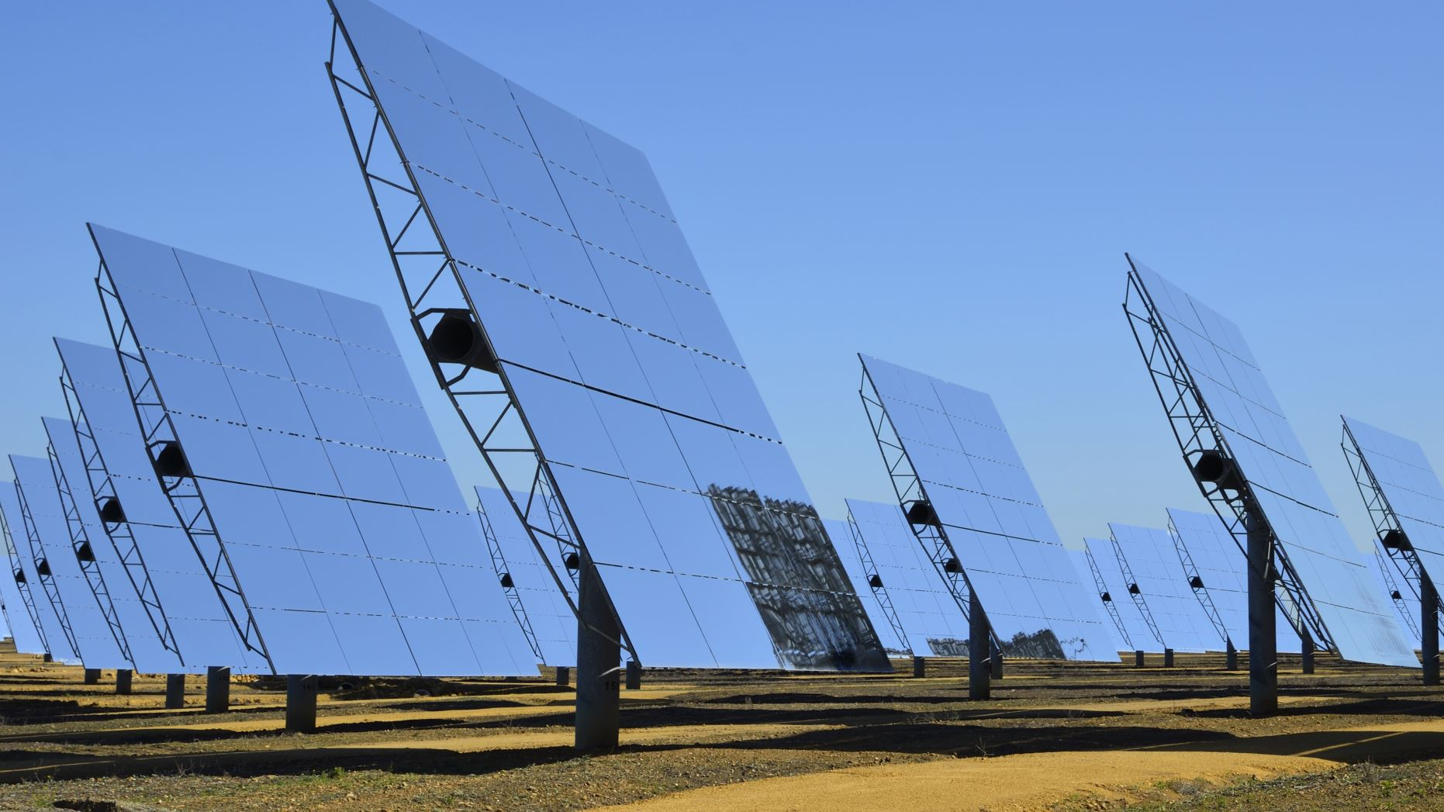
Opportunities
Renewable Energy Potential: With abundant sunshine, Cyprus has the opportunity to expand solar energy infrastructure, reducing dependency on imported fuels and promoting sustainable growth.
EU Partnerships: As an EU member, Cyprus can leverage funding and collaboration opportunities to enhance sectors like technology, education, and infrastructure development.
Technology and Innovation: Growth in sectors such as fintech, digital services, and high-tech industries can diversify the economy and attract international investment.

Slide 20
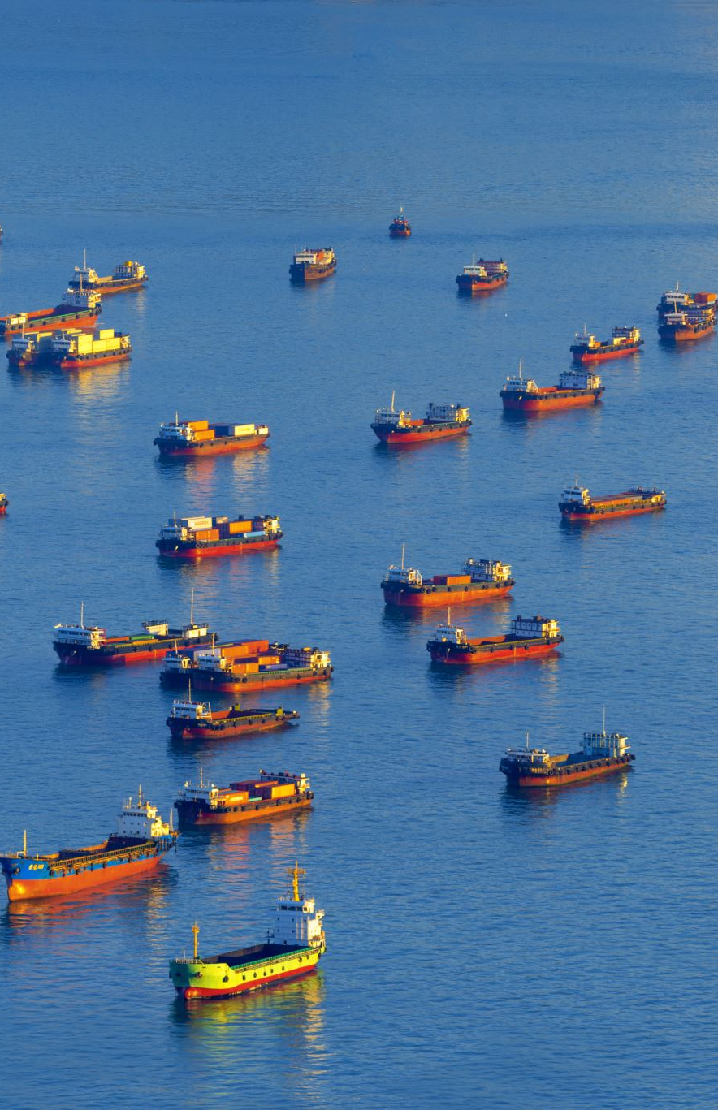
Threats
Geopolitical Risks: Regional instability and unresolved territorial disputes in the Eastern Mediterranean pose potential risks to security and economic growth.
Climate Change: Rising temperatures, water scarcity, and the threat of sea level rise present significant challenges, particularly for agriculture and coastal tourism.
Economic Shocks: Dependence on international markets and tourism makes Cyprus vulnerable to global financial instability, pandemics, or changes in consumer behavior.
Climate Change: Rising temperatures, water scarcity, and the threat of sea level rise present significant challenges, particularly for agriculture and coastal tourism.
Economic Shocks: Dependence on international markets and tourism makes Cyprus vulnerable to global financial instability, pandemics, or changes in consumer behavior.

